Slide 1
RV Institute of Technology and Management
Department of Computer Science and Engineering
JP Nagar, Kothanur, Bengaluru - 560076
PROJECT TITLE
Academic year 2025 – 2026 Odd (5th) semester
Mini Project (BCS586)
Review II Presentation
Presented by:
Nitesh Gupta- 1RF23CS104
Pulkit Sardana - 1RF23CS118
Shubham Kumar- 1RF23CS161
Under the Guidance of:
Dr.Malini M Patil
Professor Dept. of CS&E
RVITM

Slide 2
Contents
Abstract
Introduction
Objectives and Problem Statement
Proposed Model - Methodology ( Architecture diagram)
Implementation Details (Algorithm)
Results
Conclusion
References

Slide 3
Abstract
This project presents an E-commerce Recommendation System that provides personalized product suggestions using multiple machine learning approaches.
The model integrates similarity-based filtering using cosine similarity and, association rule mining using Apriori, and The system simulates industrial engines like Amazon and aims to deliver accurate, scalable, and dynamic product suggestions.

Slide 4
Introduction
Modern e-commerce platforms contain large catalogs that make product discovery difficult.
Recommendation systems analyze user behavior, item relations, and purchase patterns to deliver relevant suggestions.
We build a multi-model recommendation engine evaluating item similarity, and purchase associations to generate dynamic recommendations.

Slide 5
Objectives & Problem Statement
Objectives:
Generate personalized product recommendations using ML models.
Implement similarity filtering, association rules, and RFM segmentation.
Compare models based on accuracy and scalability.
Create a front-end for dynamic recommendations.
Problem:
Users struggle to find relevant items; we design an ML-driven system analyzing behavior and transactions to provide accurate suggestions.

Slide 6
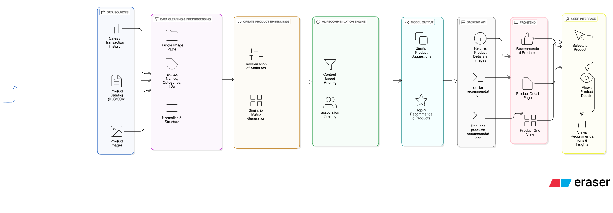
Proposed Model – Methodology
Pipeline:
Data Collection: Products, users, transactions.
Preprocessing: Cleaning, encoding, normalization.
Feature Engineering: User vectors, item vectors, RFM values.
Model Pipelines:
Cosine Similarity + Deep Learning for similarity recommendations.
Apriori for 'Frequently Bought Together' rules.
RFM + K-means for customer segmentation.
Output:
Similar items, Associated items, Segment-based recommendations.

Slide 7
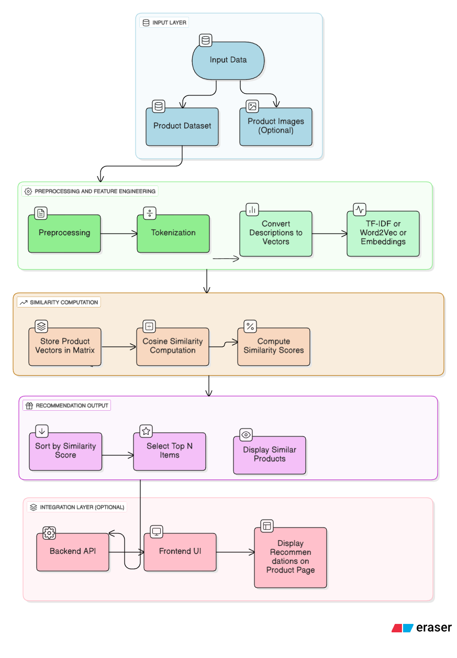
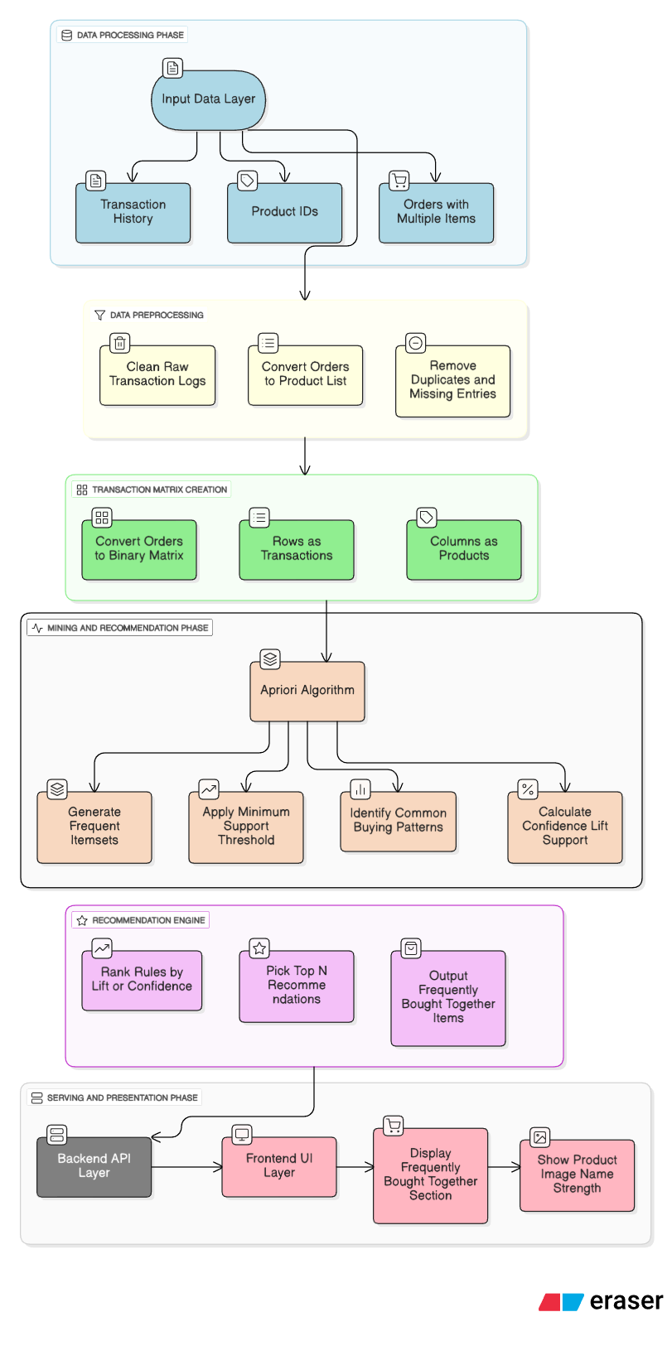
Implementation Details (Algorithms)
Similar Product Reccomendation Model
Frequently brought together model

Slide 8
Results
Expected outcomes:
Accurate personalized product recommendations.
Similar items list generated via cosine similarity.
Frequently Bought Together items from Apriori.
Customer clusters visualized from K-means.
Performance comparison of implemented models.

Slide 9
Conclusion
The system successfully integrates multiple ML models to generate personalized recommendations.
Combining similarity matching, association rules, and RFM segmentation makes the system scalable and accurate.
Future work: UI integration, deep learning optimization, real-time deployment.

Slide 10
REFERENCES
1.Zhang et al. (2020), Deep Learning-Based Recommender Systems Review.
2.Zhou et al. (2021), KNN-based Recommendation for E-commerce, Sensors.
3.Patel et al. (2022), Market Basket Analysis using Apriori Algorithm,
4.Amazon Research (2025), Amazon Recommendation Engine Overview,
5.P. Anitha, Malini M.Patil(2022), RFM model for customer purchase behavior using K-Means algorithm.

Slide 11
Thank You!

